Slide 1



Amazon Web Services
(AWS)
3. EC2 - Elastic Compute Cloud

Slide 2
Amazon EC2
EC2 is one of the most popular of AWS’s offering
EC2 = Elastic Compute Cloud = infrastructure as a Service
It mainly consists in the capability of:
  Renting virtual machines (EC2)
  Storing data on virtual drives (EBS)
  Distributing load across machine (ELB)
  Scaling the services using an auto-scaling group (ASG)
Knowing EC2 is fundamental to understand how the cloud works

Slide 3
EC2 sizing & configuration options
Operating System: Linux, Windows or Mac OS
How much compute power & Cores (CPU)
How much random-access memory (RAM)
How much storage space:
  Network-attached (EBS & EFS)
  Hardware (EC2 Instance Store)
Network card: speed of the card, public IP address
Firewall rules: security group
Bootstrap script (configure at first launch): EC2 User Data

Slide 4
EC2 User Data
It is possible to bootstrap our instances using an EC2 User data script
Bootstrapping means launching command when a machine starts
That script is only run once at the instance first start
EC2 user data is used to automate boot tasks such as:
  Installing updates
  Installing software
  Downloading common files from the internet
  Anything you can think of
The EC2 User Data Script runs with the root user (sudo rights)

Slide 5
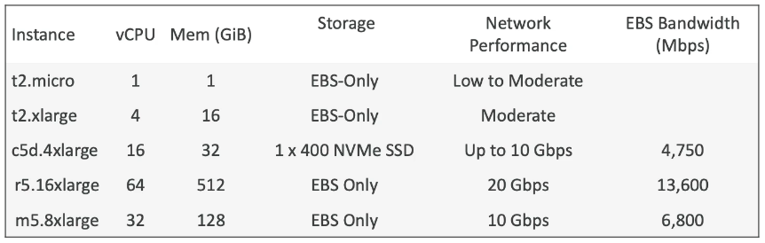
EC2 instance types: example

Slide 6
EC2 instance Types - Overview
You can use different types of EC2 instances that are optimized for different use cases (https://aws.amazon.com/ec2/instance-types/)
AWS has the following naming convention:
M5.2xlarge
m: instance class (purpose)
5: generation (hardware – AWS improve them over time)
2xlarge: size within the instance class

Slide 7
EC2 instance Types - Overview
You can use different types of EC2 instances that are optimized for different use cases (https://aws.amazon.com/ec2/instance-types/)
AWS has the following naming convention:
M5.2xlarge
m: instance class (purpose)
5: generation (hardware – AWS improve them over time)
2xlarge: size within the instance class

Slide 8
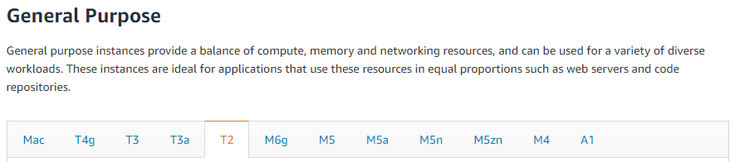
EC2 instance Types – General Purpose
Great for a diversity of workloads such as web servers or code repositories
Balance between:
  Compute
  Memory
  Networking
For example t2.micro which is a general purpose EC2 instance

Slide 9
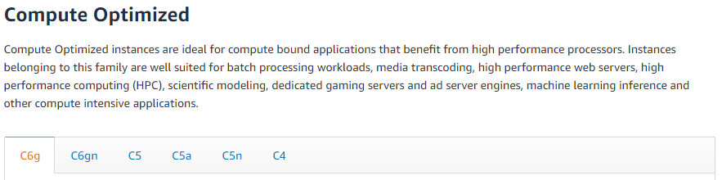
EC2 instance Types – Compute Optimized
Great for compute-intensive tasks that require high performance processors:
  Batch processing workloads
  Media transcoding
  High performance web servers
  High performance computing (HPC)
  Scientific modeling & machine learning
  Dedicated gaming servers

Slide 10
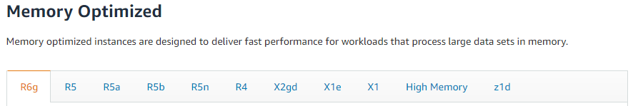
EC2 instance Types – Memory Optimized
Fast performance for workloads that process large data sets in memory
Use cases:
  High performance, relational/non-relational databases
  Distributed web scale cache stores
  In-memory databases optimized for BI
  Applications performance real-time processing of big unstructured data

Slide 11
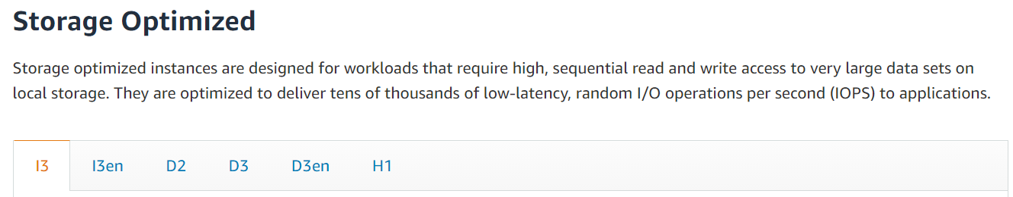
EC2 instance Types – Storage Optimized
Great for storage-intensive tasks that require high, sequential read and write access to large data sets on local storage
Use cases:
  High frequency online transaction processing (OLTP) systems
  Rational & NoSQL databases
  Cache for in-memory databases (Redis for example)
  Data warehousing applications
  Distributed file systems

Slide 12
EC2 instance types: example

Slide 13
EC2 instance types: comparizon
https://instances.vantage.sh/
(https://www.ec2instances.info/)

Slide 14
Introduction to Security Groups
Security groups are fundamentals of network security in AWS
They control how traffic is allowed into or out of EC2 instances
Security groups only contain allow rules
Security groups rules can reference by IP or by security group

Slide 15
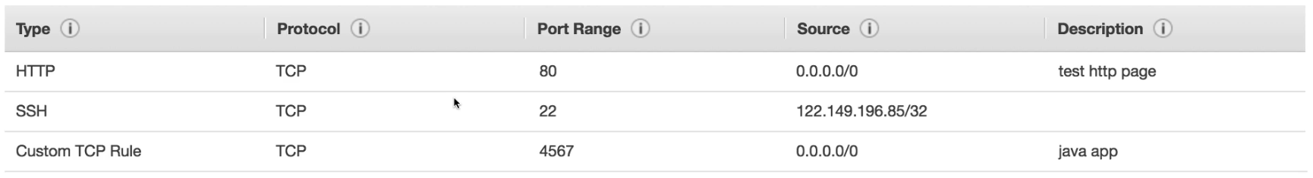
Security Groups – Deeper Dive
Security groups are acting as a “firewall” on EC2@ instances
They regulate:
  Access to ports
  Authorized IP ranges – IPv4 and IPv6
  Control of inbound network (from other to the instance)
  Control of outbound network (from instance to other)

Slide 16
Security groups diagram
EC2 instance
IP XX.XX.XX.XX
Security Group 1
Inbound
Filter IP / Port with Rules
Your Computer – IP xx.xx.xx.xx
(authorized port 22)
Other Computer
(not authorized port 22)
Security Group 1
Outbound
Filter IP / Port with Rules
WWW
Any IP – Any Port

Slide 17
Security Groups – Good to know
Can be attached to multiple instances
Locked down to region / VPC combination
Does live “outside” the EC2 – if traffic is blocked the EC2 instance won’t see it
It’s good to maintain one separate security group for SSH access
If your application is not accessible (time out), then it’s a security group issue
If your application gives a “connection refused” error, then it’s an application error or it’s not lunched
All inbound traffic is blocked by default
All outbound traffic is authorized by default

Slide 18
Classic Ports to know
22 = SSH (Secure Shell) – log into a Linux instance
21 = FTP – upload files into a file share
22 = SFTP – upload files using SSH
80 = HTTP – access unsecured websites
443 = HTTPS – access secured websites
3389 = RDP – log into Windows instance

